Slide 1
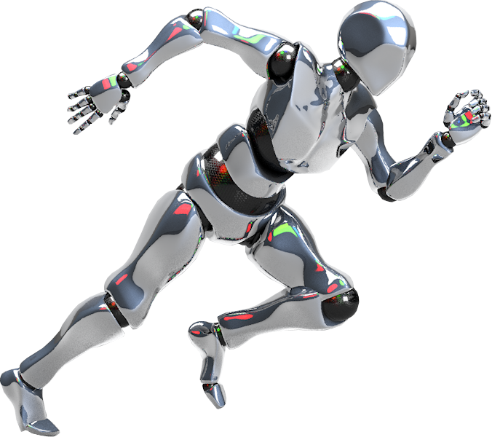
MULTI-EMOTION CLASSIFICATION SYSTEM USING ZERO-SHOT LEARNING: A GRADIO-BASED NLP APPLICATION
Sentiment Analyzer
20 November, 2025
SUDIPTA ROY

Slide 2

Motivation & Method
Why emotions?
Approach:
Python + Gradio front end
Hugging Face facebook/bart-large-mnli pipeline (zero-shot classification)
Map user text → normalized percentages for each emotion.
Data: No fine-tuning; leverages pre-trained knowledge (saves time, ensures robustness).
Understanding subtle emotional signals supports personalization, creative writing, and content moderation beyond simple positive/negative sentiment.
Task: Multi-label emotion scoring (admiration → surprise).

Slide 3
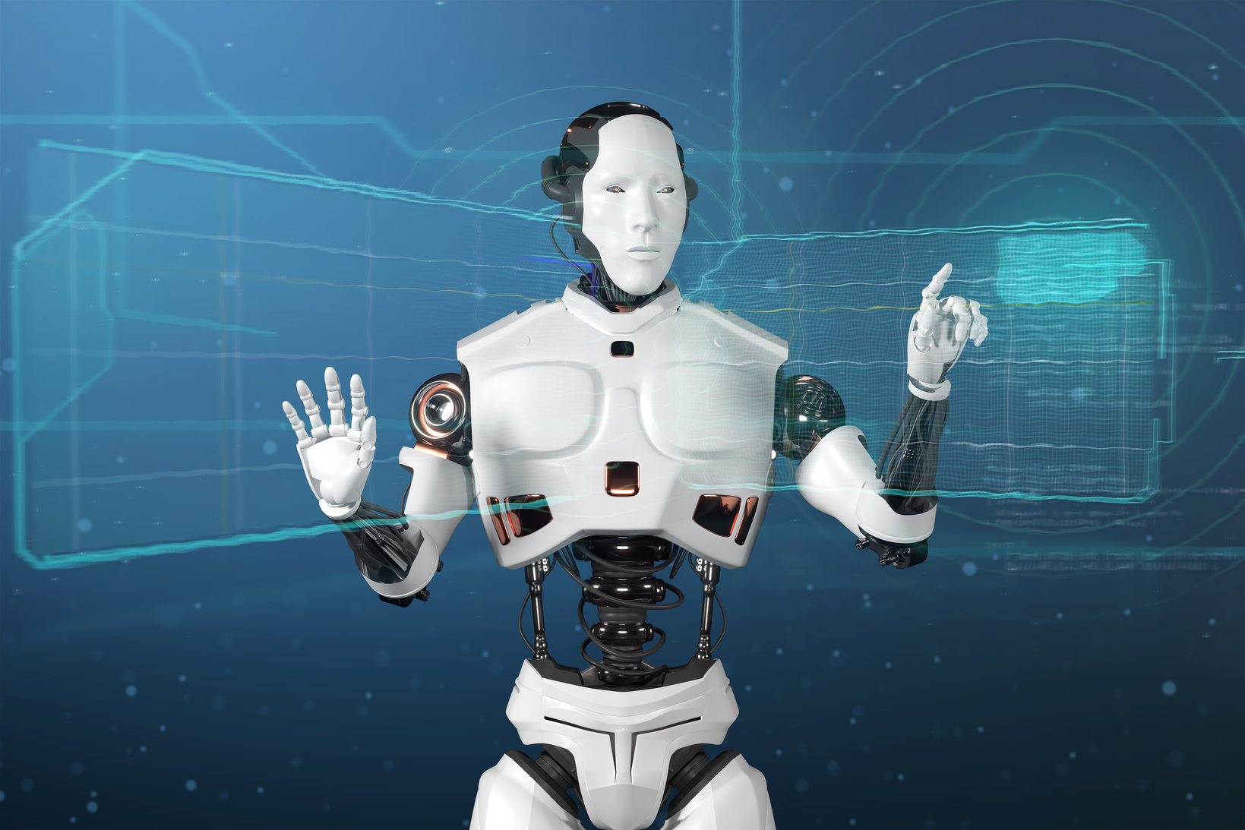
System Design & Implementation
Architecture
User inputs free text.
Pipeline trims text, feeds it to model with 27 candidate labels.
Model returns scores → normalized percentages.
Gradio UI shows dominant emotion + table.
Key libraries
Gradio
Transformers
Torch
Code quality: Modular functions (analyze emotions, clear fields, table builder), caching guard, requirements + README.

Slide 4

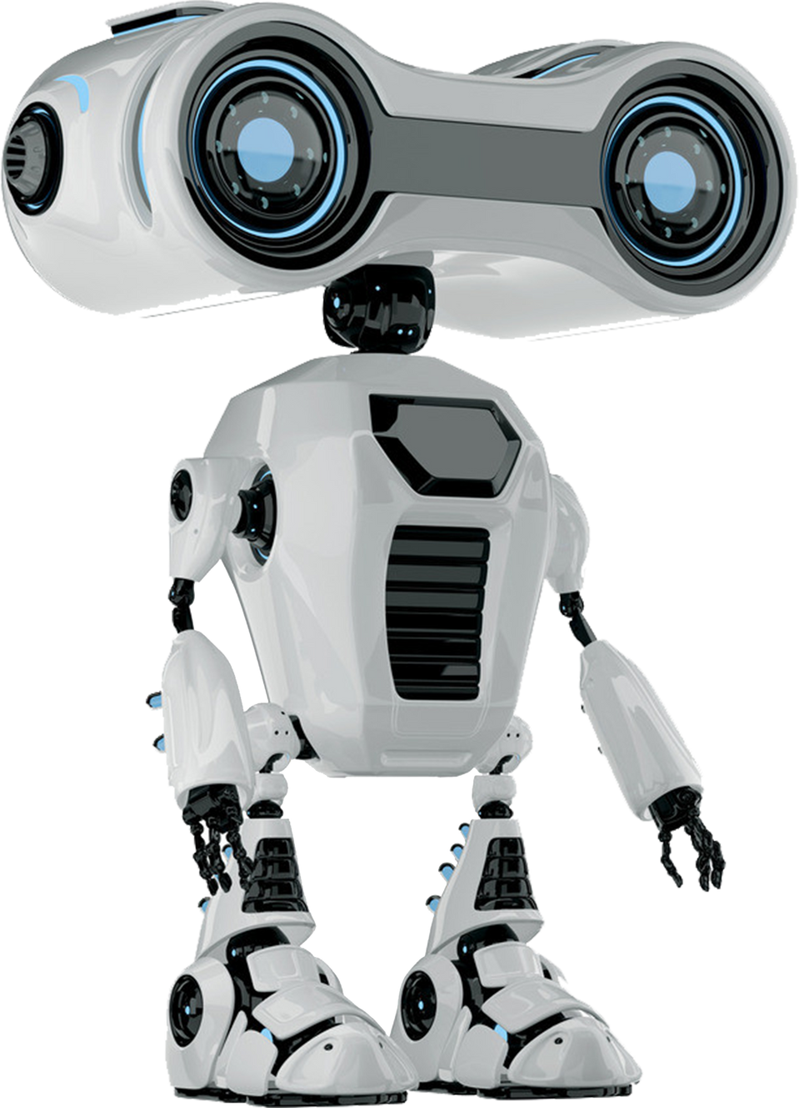
System Walkthrough & Evaluation
Flow: user text → zero-shot pipeline (27 labels) → normalized scores → summary + table.
UI highlights: glassmorphic cards, responsive layout, credits “Designed by Sudipta Roy”.
Sample results: joyful text → Joy 78%; complaint → Sadness 42%; romantic text → Romance 51%.
Performance: ~0.7 s on CPU, cache guard prevents stale outputs, works offline after local model download.

Slide 5
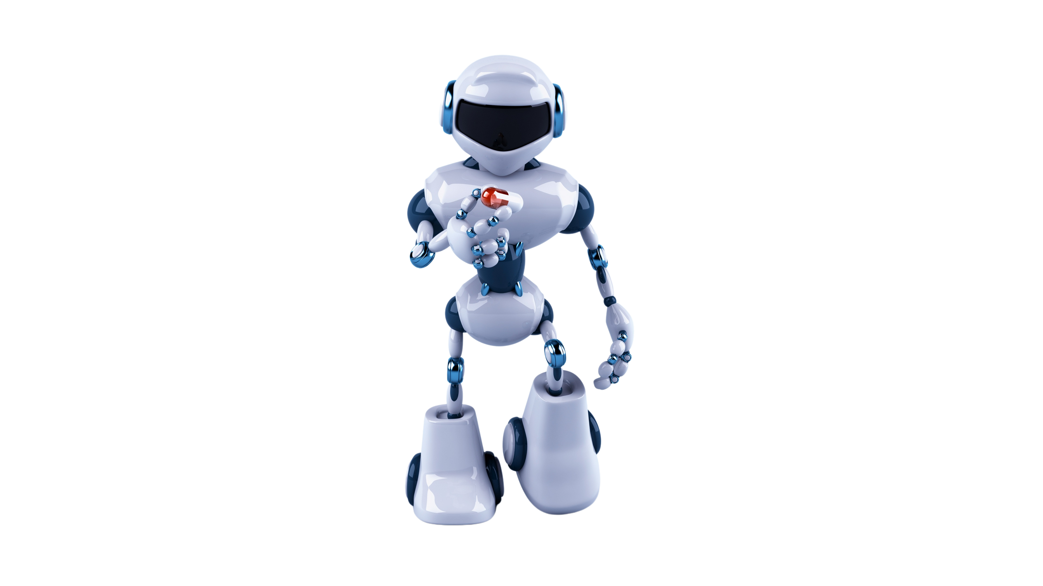
Delivered a compliant NLP app meeting all assignment requirements (Python, Gradio, interactive UI, clear labels, documentation).
Demonstrated advanced model usage (zero-shot classification) for nuanced emotion profiling.
Built a premium front end (custom theme, accessible components, clear storytelling).
Conclusion
Personal learnings:
Gradio’s rapid prototyping enabled quick UI iterations.
Managing transformer caches and large model downloads is key for smooth demos.
UX polish (contrast, spacing, copy) can elevate technical work in presentations.

Slide 6

Thank You

